Slide 1
The Mini-Paper
COM 318
Due Thursday, November 14

Slide 2
Mini-Paper Overview
Worth 50 points; must be at least 3 pages and no longer than 4 pages. Write them well!
Requires you to do five specific things…
Describe a principle of persuasion
1 to 1½ pages
Describe how YOU put this principle into practice
No more than 1 page
Evaluate the success of your attempt
1 to 1½ pages
Use three outside sources
ALL RESEARCH SOURCES MUST be from a source other than the books from class
Submit your paper through SafeAssign AND Blackboard.

Slide 3
Part One
Describe a principle of persuasion (1 to 1½ pages)
You are ONLY TO WRITE ABOUT ONE principle, theory, or technique—you will be penalized otherwise.
You cannot simply state, list, or mention the principle, theory, or technique. You have to demonstrate a thorough understanding of an approach by describing it in detail.
What principles, theories, or techniques might you use? These are just some examples:
Cognitive dissonance theory
Scarcity
Social proof
Reciprocity
Any ONE of the sequential persuasion techniques (foot-in-the door, door-in-the-face, pregiving, etc.)
There is no theory called persuasion theory…you will not do well if you state which theory you use.
These listed are probably the ones you most likely use…if you’re not sure if what you’re writing about is a legitimate option, e-mail your TA.
Information you should include: thorough description of what the principle/theory/technique is, what it does, when to use it, under what conditions it is most/least successful, how it is applied in the real world. Do not talk about your own experience in this section. This should be 1 to 1½ pages of you demonstrating a mastery of your chosen topic.

Slide 4
Part Two
Describe how you have put this principle into practice (NO MORE THAN 1 page)
Here you are writing about how YOU put this principle into practice—no hypothetical situations, no made-up examples; this section should reflect how you have used your chosen principle/theory/technique of persuasion into practice.
Information you should include: an introductory paragraph to set up the situation; a thorough explanation of how you put the principle into practice
Provide details about the situation—who said what? Provide examples of the interaction/persuasion attempt

Slide 5
Part Three
Evaluate the success of your persuasion attempt (1 to 1½ pages)
This is the section that students struggle with the most. It requires you make sense, through your own analysis, of why your persuasion attempt did or did not work. You must link specific aspects of the situation you described with specific aspects of the principle/theory/technique. If you don’t make explicit connections between parts one and two, you will lose a lot of points here.
In other words, explain why you were successful, or how you could have been successful. Explain in what ways you could improve on your persuasive attempt in similar future situations.

Slide 6
Part Four
Use three sources and write well
You must incorporate three sources into this paper. You can use the books from class—but these do NOT count as one of your three sources.
Write like you’re an advanced college student—you will be graded on the quality of your writing.
Must use APA style (6th ed.)
Exceptions are that you do not need a cover page or an abstract—your running head should be your name as it appears on the course roster

Slide 7
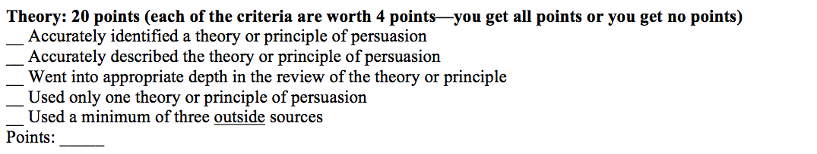
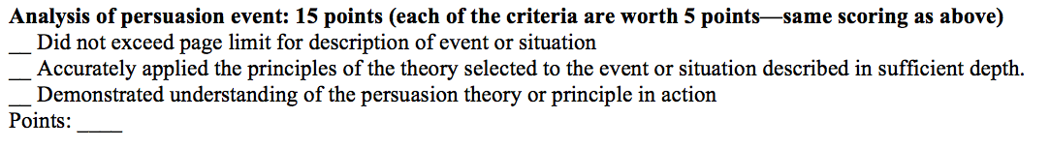
How will this paper be graded?
The rubric is in your syllabus if you want to reference it after today. Each rubric section is, indeed, all or nothing.

Slide 8
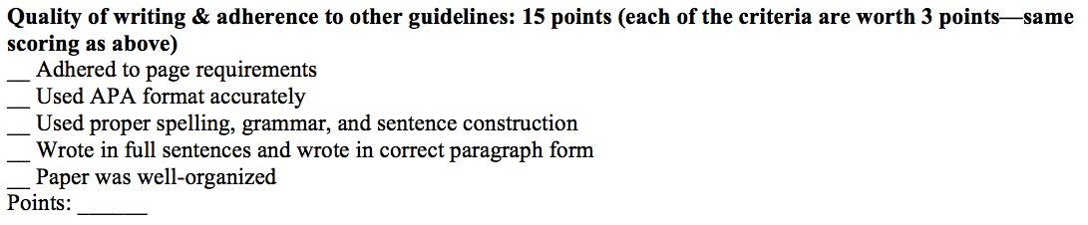
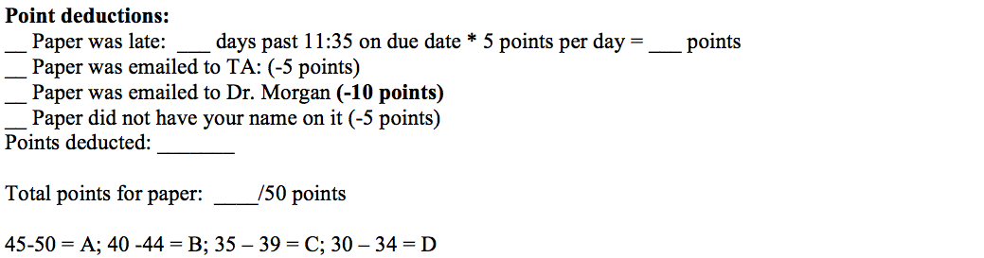
How will this paper be graded?

Slide 9
Common issues…
SafeAssign is down
This happens from time to time. If you turn your paper in early, this problem will not affect you. Typically SafeAssign is not down for more than 20 minutes at a time.
Papers turned in late electronically via Blackboard
SafeAssign is how you turn your paper in. What is convenient about this is that it tells us exactly when you uploaded your paper. Late papers are accepted with a five-point deduction for each day late.
Use multiple theories
Unlikely you’ll get higher than a B or C

Slide 10
Common issues…
Write too much (more than one page) about your situation
Fail to use three OUTSIDE sources or don’t use APA style
Check the OWL website
Your paper MUST use 12-point font—and Times New Roman at that—and have 1-inch margins on all sides.
Don’t use a header like this…

Slide 11
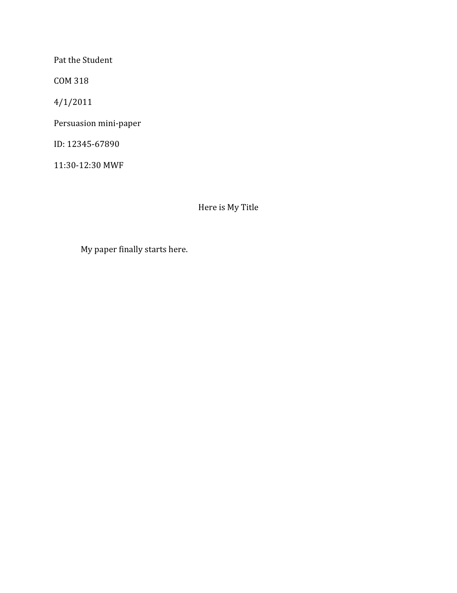

Slide 12
Common issues…
Don’t do the assignment according to the rubric/criteria
You increase your chances of doing well by writing a little over one page explaining ONE theory/principle, then one page on your situation, and then the remainder of the paper making connections between research on that principle and how you applied said principle.

